Slide 1

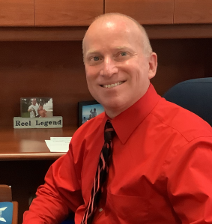
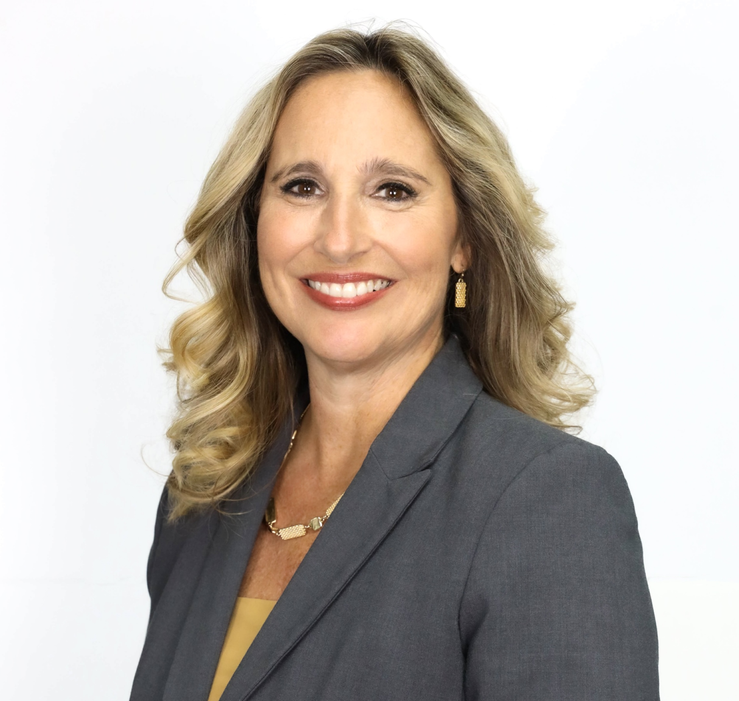
Marion Technical College
Student Orientation
  Gary Smallridge, Director
  Gary.smallridge@marion.k12.fl.us
  Kim Martsolf, Assistant Director
  Kim.Martsolf@marion.k12.fl.us

Slide 2

Campus information
Mariontc.edu
Code of Student Conduct
  Student Handbook
  Academic Integrity
  Academic Probation
  Acceptable Dress/Badge
  Replacement $5.35

Slide 3
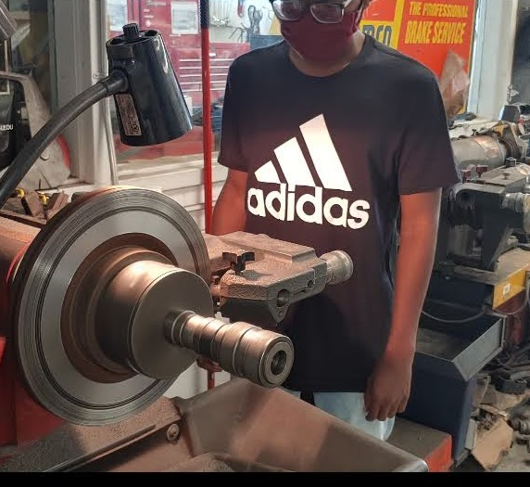
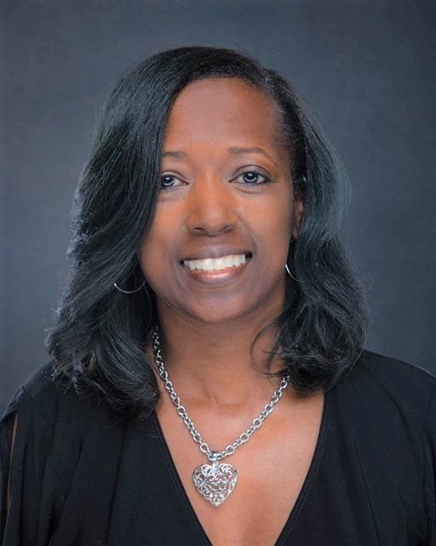
Financial Aid
Satisfactory Academic Progress
Communication with Financial Aid
Importance of Email
States
Residency requirements/ Reclassification opportunity
Financial Aid Information - Click Here
  Anissa Damon, Coordinator
  Anissa.Damon@marion.k12.fl.us

Slide 4
Satisfactory
Academic PROGRESS (SAP)
Satisfactory Academic Progress (SAP) is defined as the successful completion of coursework toward an eligible certificate or degree.
Regulations require Financial Aid to monitor the academic progress of students receiving Title IV aid and Veterans Educational benefits.
  Qualitative Measure (GPA)
  Quantitative Measure for Attendance
  Maximum Time Frame (Completion)
Monitored at each payment period
GPA: 2.0
PACE: Measured in hours AND weeks
MTF: 150% of scheduled hours
Attendance: 90% minimum

Slide 5

CLOCK HOUR PROGRAMS
In its simplest form, a clock-hour program is a set of non-credit courses that lead to the completion of a non-degree credential or certificate.
Typically offered in the field of career and technical education (CTE).
Please be present for class.

Slide 6
FOCUS – Grades and finance
Accessing Your Information
Direct:
  Marion.FocusSchoolSoftware.com
    Login: Student ID Number
    Password: 8 Digit Birthday (05031999)
Website:
  MarionTC.edu has a link for FOCUS
Email and
Microsoft Office 365
Web address:
    Https://www.Office.Com
Login:
  First name.Last name@mariontc.Edu
  Example: sarah.Smith@mariontc.Edu
Password:
  Teacher will have password available
  Student Services will also have the list

Slide 7
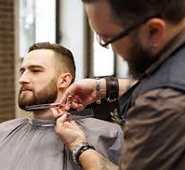
Protecting Your Private Information
FERPA
HIPAA
Senate Bill 524
https://offender.fdle.state.fl.us/
1-888-357-7332

Slide 8

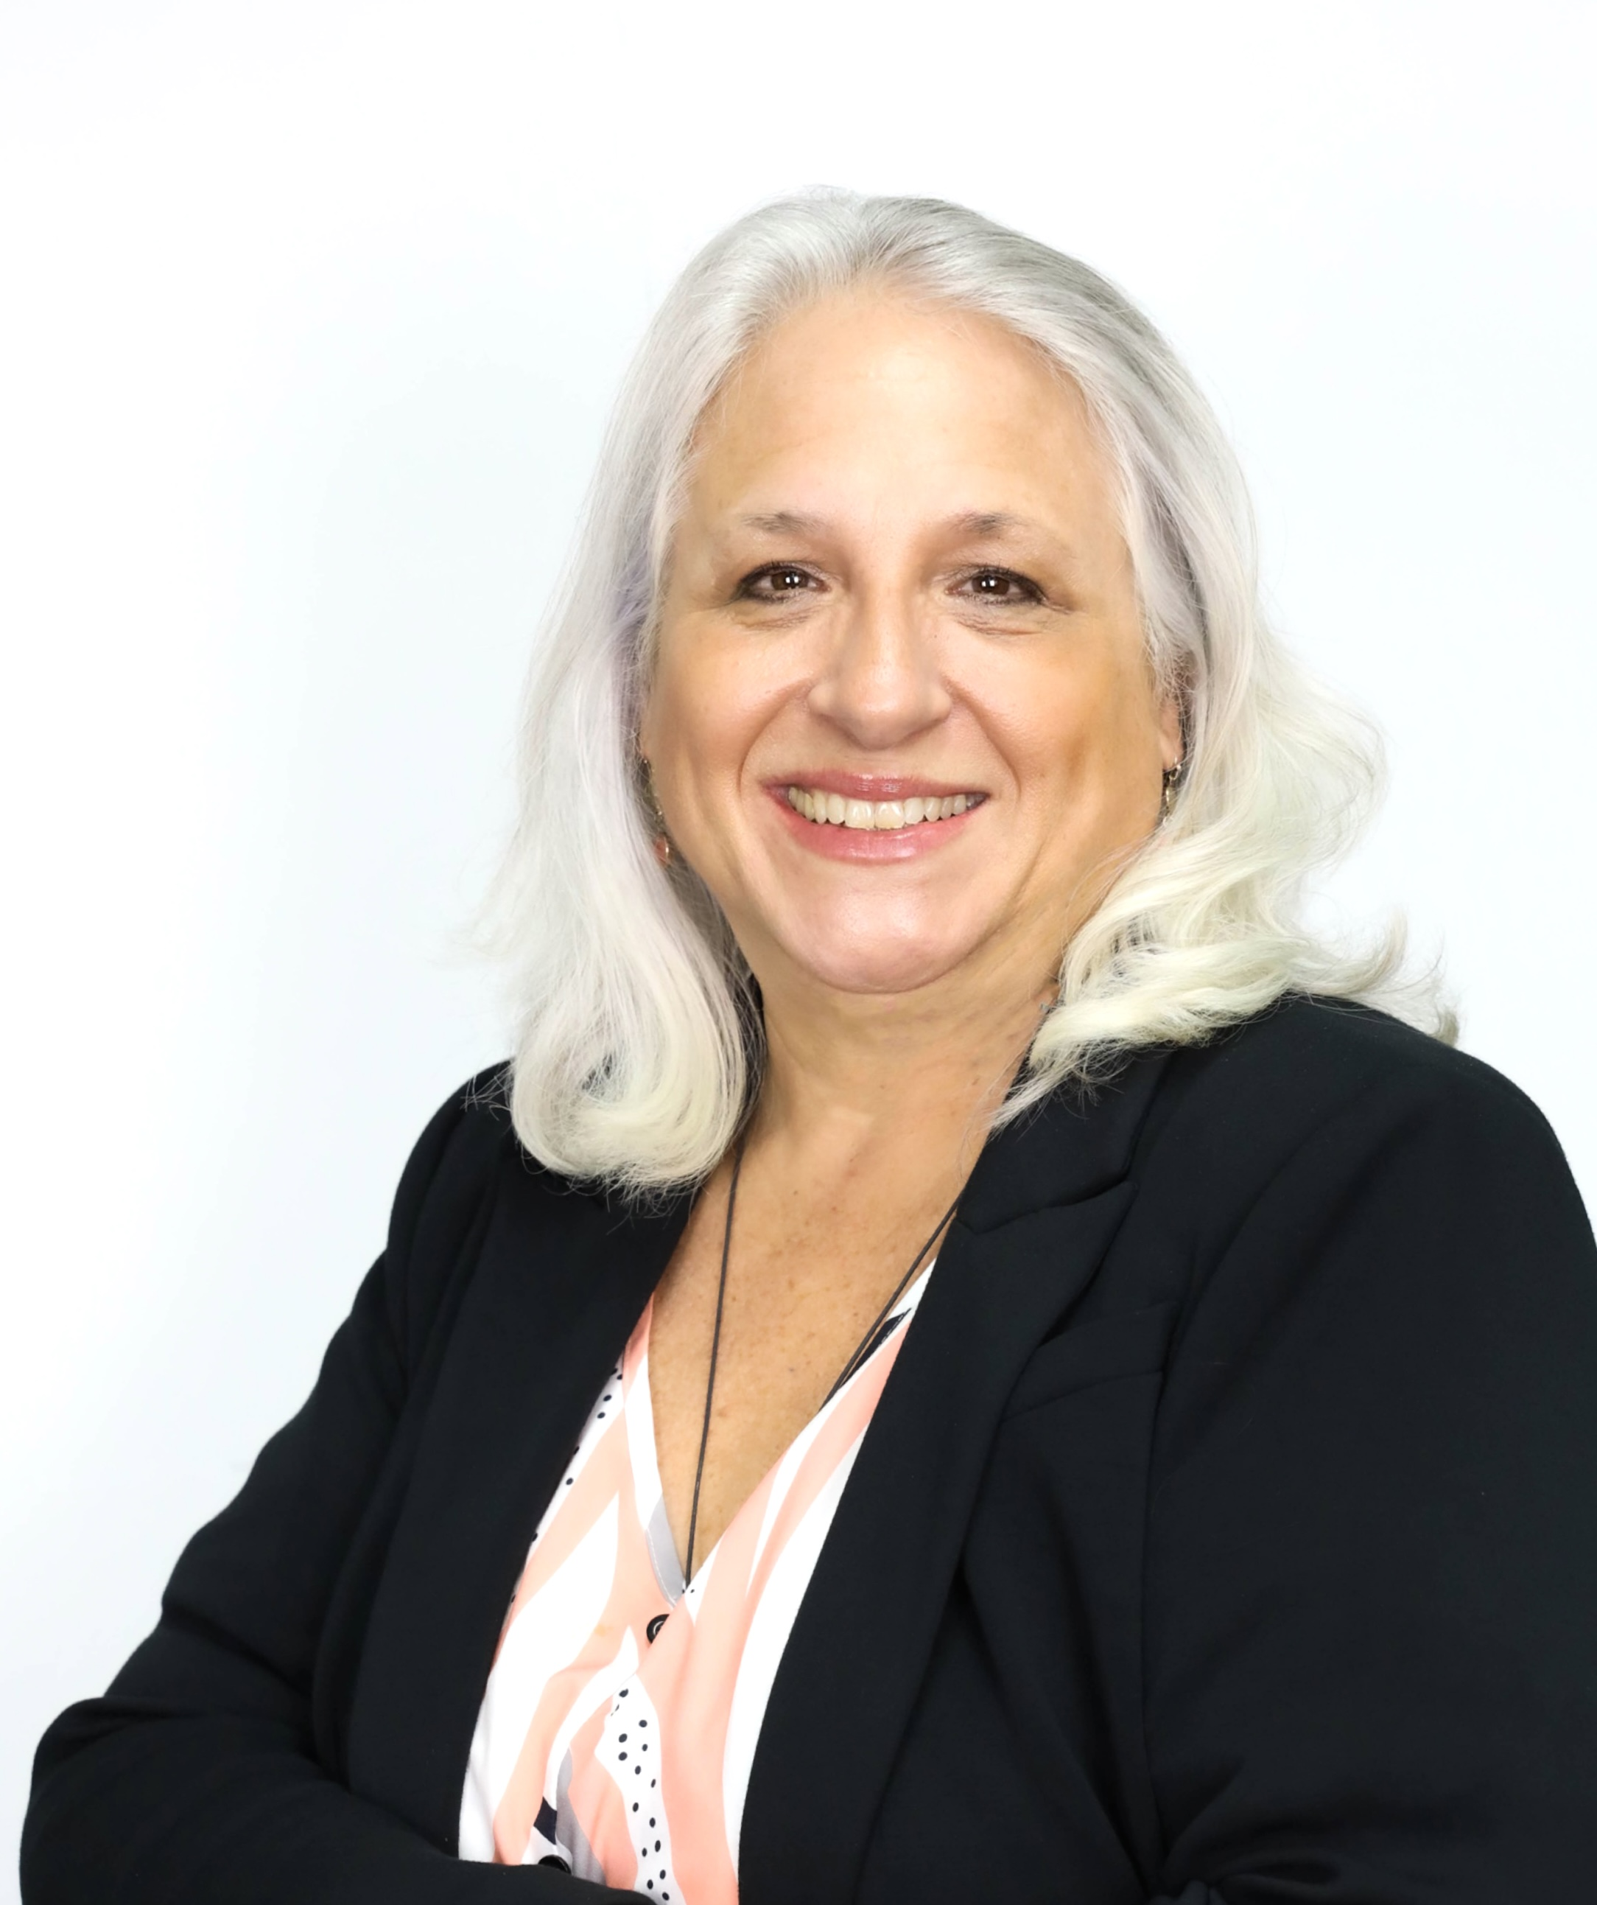
Basic Skills Requirement
PERT TEST
  First attempt required within 6 weeks
  One-time fee of $15
  You do not need this test to take the course however, MTC is required to test students.
  IN MOST CASES, WHEN YOU PASS AN INDUSTRY CERTIFICATION, YOU WILL NOT NEED TO RETEST FOR THE PERT.
  If you do not pass the industry certification your certificate will not be awarded without the completion of the Basic Skills knowledge test.
Several Exemptions to Basic Skills Requirements:
      The program is less than 450 hours
      Serving as an Active-Duty Member of the Military
      PERT, ACT, SAT within the last two years and passed
      Graduate of High School 2007 and beyond
      Passed the 2014 GED
      Associate’s Degree or Higher
  YOU DO NOT NEED TO PASS THIS EXAM TO STAY ENROLLED IN YOUR CTE PROGRAM
  CALL OR STOP BY STUDENT SERVICES TO SCHEDULE YOUR PERT EXAM!
  Laurel Lapane, Coordinator
  Laurel.Lapane@marion.k12.fl.us

Slide 9


Student & College Activities
Calendar Information
Student Appreciation Days
Student Resource Room
Guest Speakers
Volunteer at Information Sessions
Career Fairs/Industry Connections
Resume Help
WE ARE STUDENT FOCUSED!!
Two Types of Competition
Leadership Skills
Technical Skills
Advisor is Donald Ray
Donald.ray@marion.k12.fl.us
Graduating Students with a 3.5 GPA or higher & 95%
attendance rate
$40 Membership Fee
Advisor Kim Heitmuller
Kim.Heitmuller@
Marion.k12.fl.us
  Laurel Lapane, Coordinator of Student Services
  Laurel.lapane@marion.k12.fl.us

Slide 10
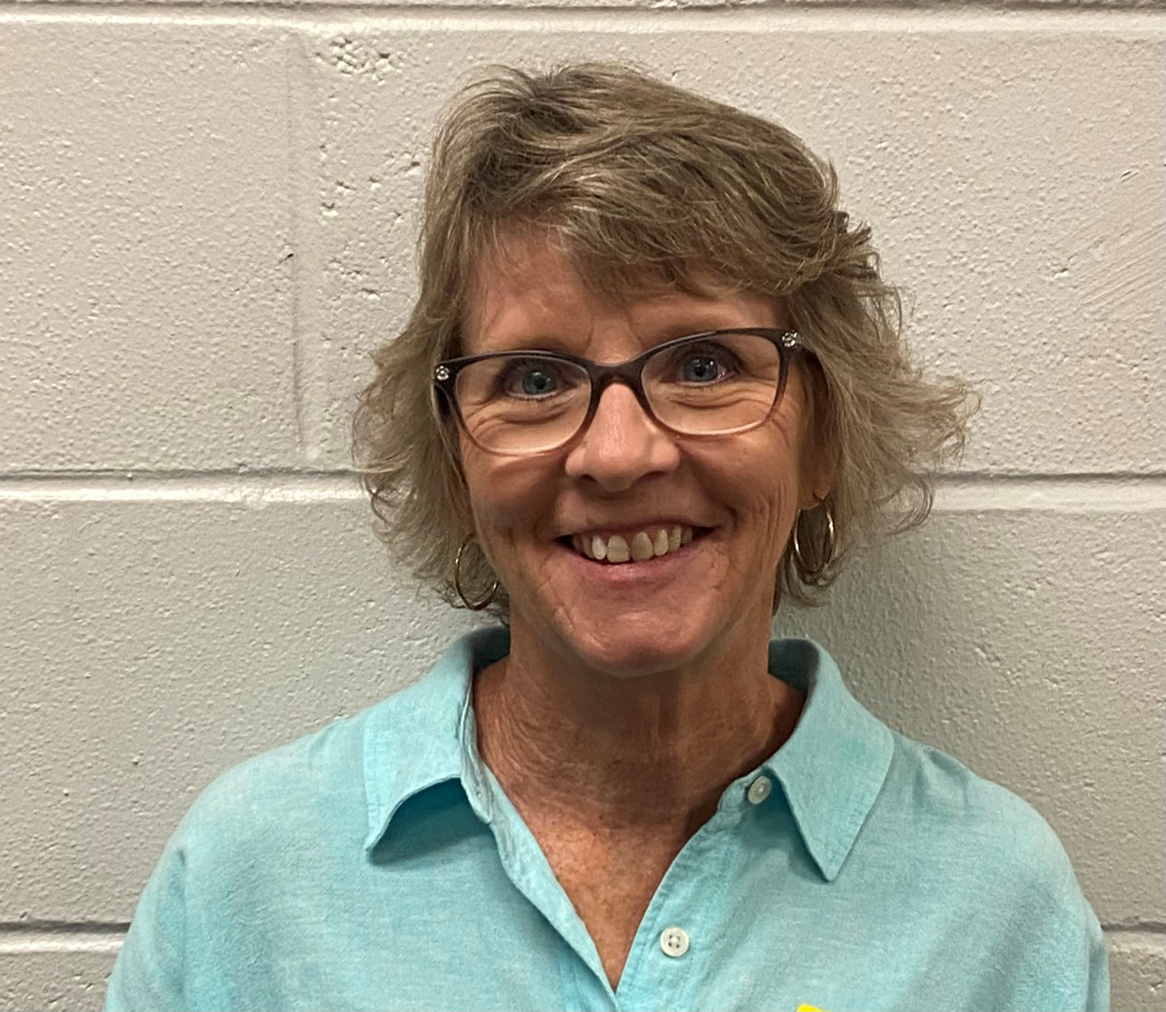

STUDENT SUPPORT
School Counselor – Kim Heitmuller
Office - Student Services
Email - Kim.Heitmuller@marion.k12.fl.us
Phone - 352-671-7200
ACADEMIC SUPPORT
COMMUNITY RESOURCES & CONNECTIONS
EMOTIONAL SUPPORT
CAREER COUNSELING

Slide 11

Graduation
December Graduation – Thursday, December 17, 2026
June Graduation – First Baptist Church
  Monday, June 10th, 2027
http://www.mariontc.edu/

Slide 12
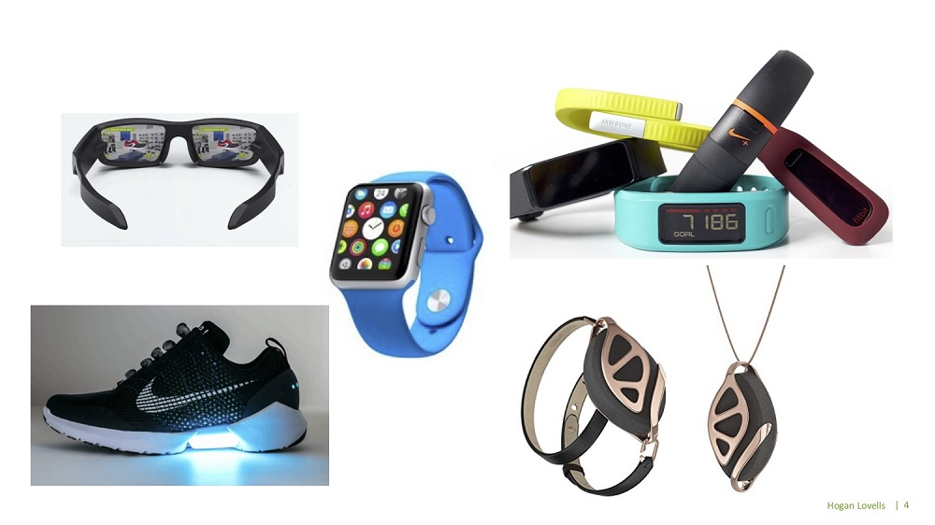
Wearable technology
Wearable Technology refers to any electronic device worn on the body that is capable of recording, photographing, filming, listening, transmitting, receiving, storing, displaying, or processing information. This includes devices equipped with wireless communication, internet connectivity, artificial intelligence (AI), or similar technologies.
Examples include, but are not limited to:
  AI-enabled smart glasses (such as Meta Ray-Ban Smart Glasses or similar devices)
  Recording or camera-equipped eyewear
  Smart watches
  Smart rings
  Smart earbuds or headphones
  AI-enabled wearable devices
  Fitness trackers with communication or recording capabilities
  Any future wearable device capable of capturing, transmitting, receiving, or processing information
  Conventional prescription eyeglasses and contact lenses that do not possess electronic, recording, communication, or artificial intelligence functions are not considered wearable technology under this policy.
The Photo by PhotoAuthor is licensed under CCYYSA.

Slide 13
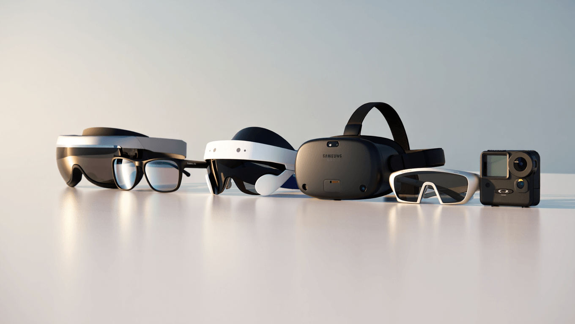
To protect privacy, maintain academic integrity, and promote a safe and professional educational environment, students may not wear or use prohibited wearable technology during:
      Classroom instruction
      Laboratory activities
      Skills demonstrations
      Simulation experiences
      Testing or examinations
      Clinical, practicum, internship, field experience, or externship assignments
      Any educational activity where patient, student, employee, or institutional confidentiality may be compromised
Wearable technology may not be used to record, photograph, livestream, transmit, receive, search for information, communicate with others, or utilize artificial intelligence during any educational activity unless specifically authorized in writing by the instructor for instructional purposes.
The Photo by Photo Author is licensed under CCYYSA.

Slide 14
Available at the Front Desk
MTC’s website: mariontc.edu
Found by clicking > Admissions/Plans and Procedures
Educational Resources
Educational Resource Plan
Technical Infrasctructure
Privacy, Safety and Security Plan
Health and Safety
Student Health and Safety Plan
  Anissa Damon, COE Liaison
  Anissa.Damon@marion.k12.fl.us

Slide 15
A.L.I.C.E. Protocol Drill
A.L.I.C.E. Protocol Drill
This Safety Drill is different than the rest. This drill uses different classroom procedures for students in the event of an active threat on campus. The district, as well, as the nation, has mandated a specific protocol to use during this drill. It is called the A.L.I.C.E. Protocol.
Alert, Lockdown, Inform, Counter, and Evacuate (ALICE)
The Marion County School District has implemented the Alice Protocol in the event of an active shooting.

Slide 16
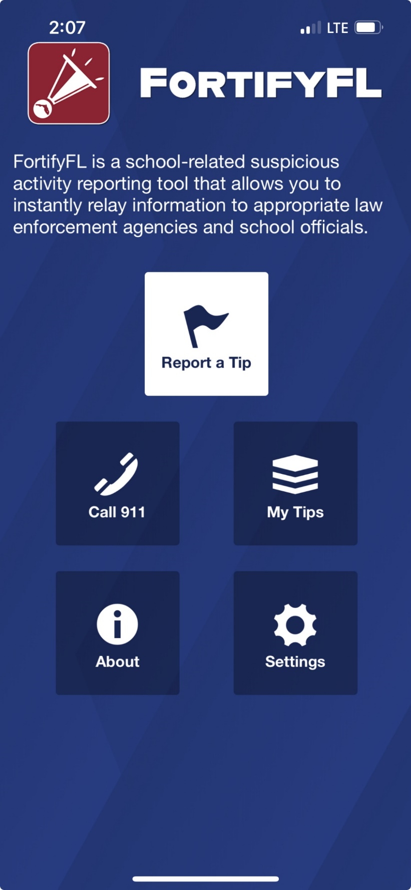


Anonymous Reporting App
Notes:
Suggested talking points:
The safety of our students is very important.
FortifyFL is a website and an app where anyone can report safety concerns.

Slide 17
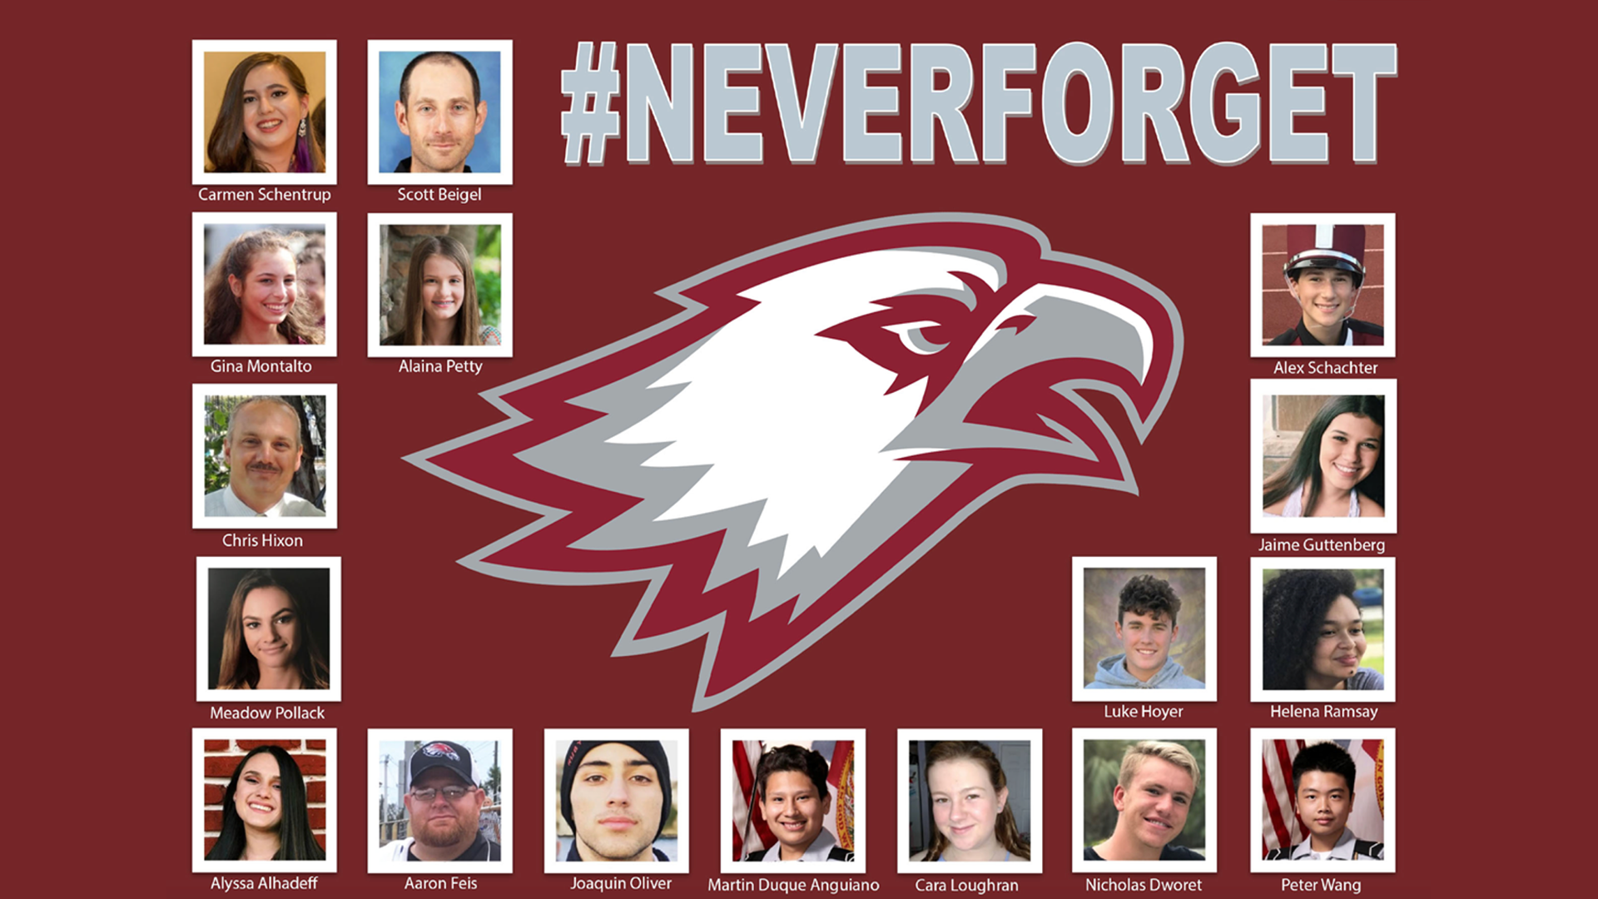
Check out this video about FortifyFL
Notes:
On February 14, 2018, at Marjory Stoneman Douglas High School, 17 people were killed and another 17 were seriously injured in a school shooting.
The shooter exhibited many warning signs that he was on the path to violence. Following this tragic event, investigators learned that numerous people – mostly fellow students – knew about concerning statements and behaviors attributed to the shooter leading up to February 14, 2018.
FortifyFL is a tool that you can use if you know about someone wanting to hurt themselves or others.

Slide 18

You Should Know:
There is an anonymous reporting app that allows you to instantly send information about suspicious activity.
Notes:
Anyone can choose to remain anonymous using the FortifyFL website or app.

Slide 19
See Something, Say Something
With FortifyFL, you can submit tips about potential crimes or threats which are sent directly to law enforcement and designated school personnel.
Notes:
See Something, Say Something, Do Something.
Users can instantly send information about suspicious activity, crime, serious threats, etc., to local law enforcement and school officials.

Slide 20
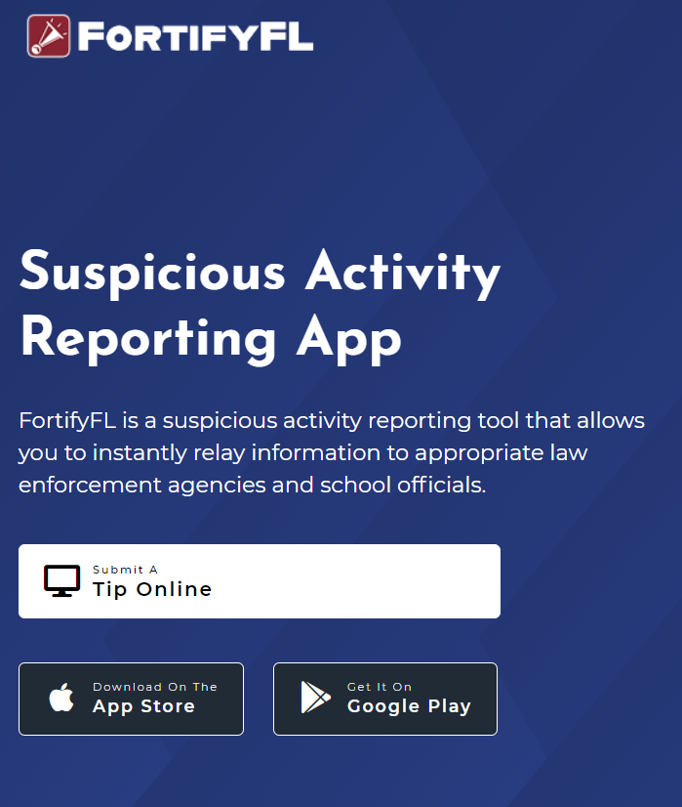
How do I submit a tip?
You can submit a tip from any computer at: GetFortifyFL.com

Slide 21


How do I submit a tip?
You can also submit a tip using your phone. Download the FortifyFL App on your phone or tablet.

Slide 22
How do I submit a tip?
Tips must have actionable information.
This means including WHO did WHAT, WHERE it happened and WHEN.
More tip details improve the chances that a situation can be resolved.

Slide 23
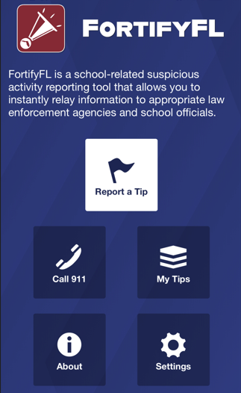
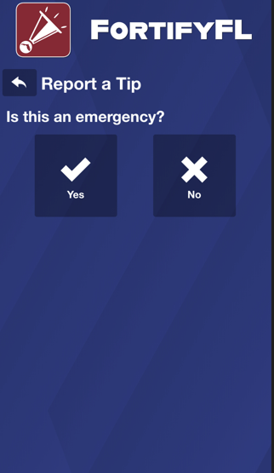
How do I submit a tip in the app?
Click “Report a Tip” and indicate if it is an emergency

Slide 24
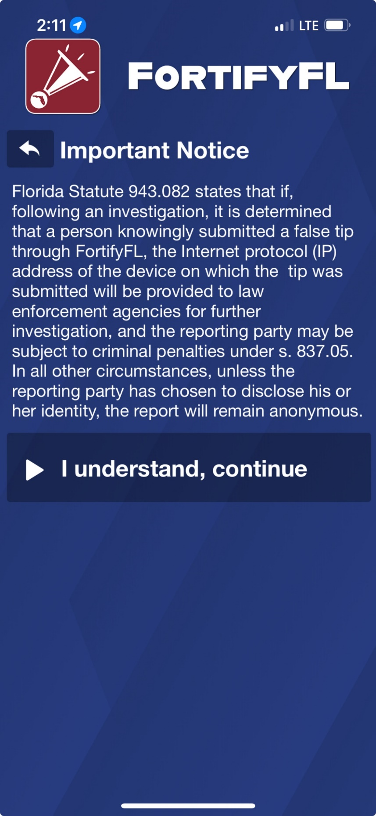
How do I submit a tip?
Important Notice:
Per Florida law if someone knowingly submitted a false tip through FortifyFL, device information will be provided to law enforcement, and the individual could be subject to criminal penalties.
Notes:
It is important to understand that knowingly submitting a false tip through FortifyFL is a serious offense (a 3rd degree felony).

Slide 25
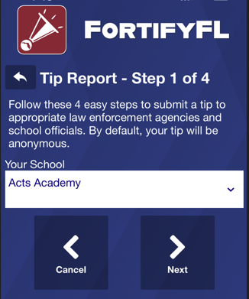
How do I submit a tip?
Step 1:
Select Your School

Slide 26
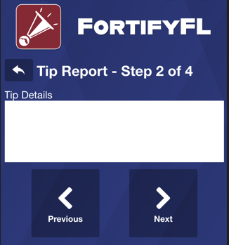
How do I submit a tip?
Step 2:
Provide Your Tip
Be sure to give enough information to get the right kind of help.
A student on my bus (#302) had a gun he was showing off. I don’t know his name but he’s got red hair and wearing a light gray hoodie with a triangle logo on it.
Notes:
The tip reads, “A student on my bus (#302) had a gun he was showing off. I don’t know his name but he’s got red hair and wearing a light gray hoodie with a triangle logo on it.”
This tip includes:
WHO - a student on bus 302 with red hair and wearing a light gray hoodie
WHAT - a gun
WHERE - on bus 302
This tip has good information; it’s missing the WHEN – did this happen this morning? Last week?
Tips are useful when they include actionable information.
Please provide enough detail.
Some examples of tips that are not as useful – taken from FortifyFL:
Someone posted a pic on snap of a gun saying he will shoot up the school on may 20th im scared
Student assaulted a teacher by kicking and punching her.
There's a girl in the hallway taking about framing a boy
there was a threat i am scared
Mutual friend was shown a gun in the classroom
This one boy keeps following me to my classes and tried to give me a hug and kiss
Individual is posting disturbing content on his social media, threatening to “kill the ***s”, posting about explosives etc
Vague information is not helpful – if someone is in crisis, who? If there is unsafe activity on campus – where?

Slide 27
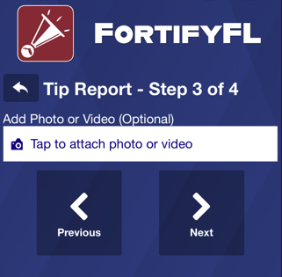
How do I submit a tip?
Step 3: Attach an Optional Photo or Video

Slide 28
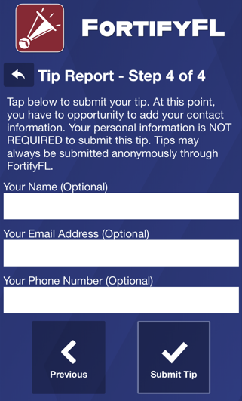
How do I submit a tip?
Step 4:
Provide Optional Information and Submit Your Tip
Notes:
If there is a need to remain anonymous, then skip this section. If you are worried that others will know about your tip, just remember that your tip is not public. When you include your name and other information, you help those who may need to ask you questions.

Slide 29

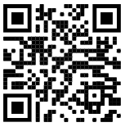
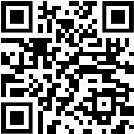
Thank you for helping to keep our school and community safe
Notes:
Reporting through FortifyFL keeps us all safe.
Thank you.
For the teacher - If there are questions about why we have FortifyFL, here is the history:
FortifyFL was created and funded by the 2018 Florida Legislature as part of the Marjory Stoneman Douglas High School Public Safety Act. The application was named by students from Marjory Stoneman Douglas High School. The Office of Attorney General, Department of Education and Florida Department of Law Enforcement coordinated its development and roll-out.

Slide 30

Questions?
Please fill out your acknowledgment
of this information sharing session.

Slide 31

Questions?
Congratulations!
Welcome to the MTC family! We are happy you are here!
Revised 8-5-2026

